Slide 1


Indian Institute of Information Technology Nagpur
DHV PROJECT
GUIDED BY SANTOSH SAHU
Topic:Stock Price Analysis and Prediction
Presented by
G SAI ANANYA(BT23CSD056)
Y SAI JAYA VARSHITH(BT23CSD040)
B BHANU PRAKASH (BT23CSD047)

Slide 2
What Are Stocks?

Slide 3

Stocks, also known as equities or shares, represent ownership in a company. When you purchase a stock, you buy a small piece of that company, becoming a shareholder. Stocks are traded on stock exchanges like the New York Stock Exchange (NYSE) or NASDAQ, where their prices fluctuate based on various factors.

Slide 4
PROJECT DESCRIPTION

Slide 5

This project aims to develop a stock price analysis and prediction system that leverages historical and fundamental financial data to provide insights into stock trends, company performance, and market movements. The system incorporates data preprocessing, exploratory data analysis (EDA), and predictive modeling to help users make informed investment decisions.

Slide 6
Application of Project

Slide 7

1. Investment Decision-Making:
Investors can use the system to analyze a company's financial health and predict future stock prices. This helps them make more informed decisions when selecting stocks to buy, hold, or sell.

Slide 8

2.Educational Purposes:
The system can be used by students and educators in finance and data science fields to understand how to apply financial analysis, data visualization, and machine learning to real-world stock market data.

Slide 9

DataWrangling and Data Handling
Data wrangling is the process of cleaning, structuring, and transforming raw data into a usable format for analysis. It's also known as data munging or data blending.
01
Data handling is the process of collecting, storing, managing, and analyzing data in a secure and accurate way. It can also refer to the process of ensuring that research data is stored and disposed of safely
02

Slide 10
EDA
01
Measures of central tendency: This includes the mean, media, and mode
02
Measures of spread: This includes variability, variants, and standard deviation
03
The shape of the distribution: This is an important aspect of EDA
04
The existence of outliers: Outliers can skew analysis results, so it's important to identify and remove them

Slide 11
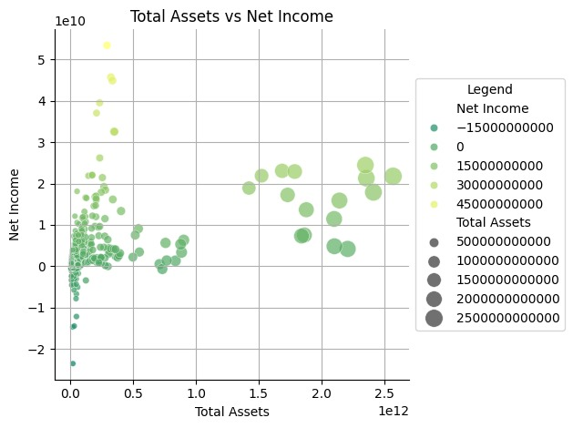
Find the Total Assets of the top 5 companies which can be viewed through the size of the dot
Total assets represent the sum of everything a company owns—both physical and intangible—used in the course of its business. These assets include cash, inventory, property, equipment, and accounts receivable, among others.
Net income (also called net profit or the bottom line) represents a company’s total earnings or profits over a specific period, after accounting for all expenses, taxes, interest, and other costs.

Slide 12
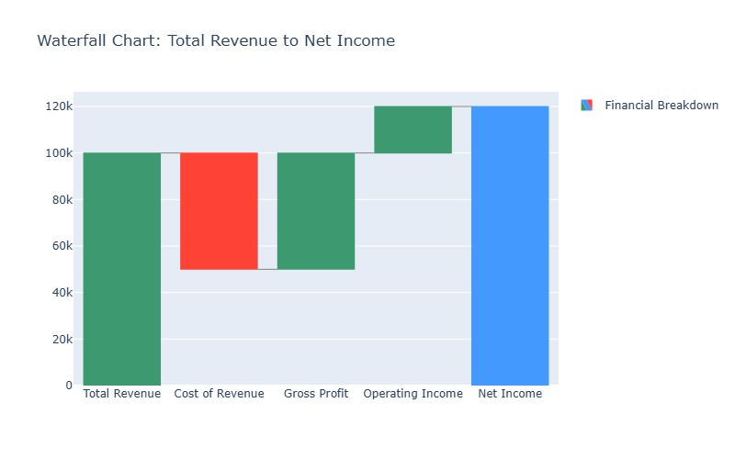
Find the Cost of Revenue and Gross Profit, what do the colours
indicate?
Total Revenue is the total amount of money generated by a company from its business activities (e.g., sales of goods, services, or investments) before any expenses are deducted.
Net Income is the profit left over after all expenses, taxes, interest, and other costs have been subtracted from total revenue.

Slide 13
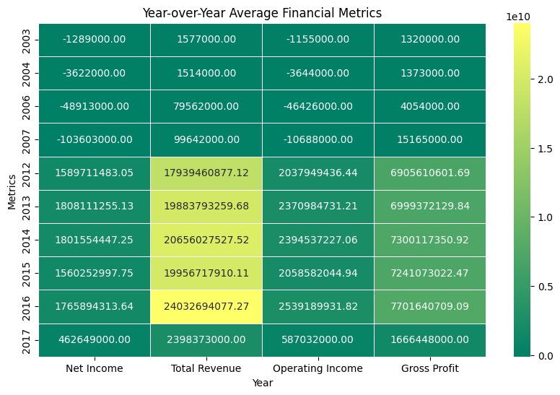
What measured have the large fluctuations between the years?
Year-over-Year (YoY) Average Financial Metrics are used to compare a company's financial performance over a 12-month period to the same period in the previous year. This helps provide context for growth, trends, and performance, smoothing out seasonal fluctuations and giving investors and analysts a clearer view of how the business is performing over time

Slide 14
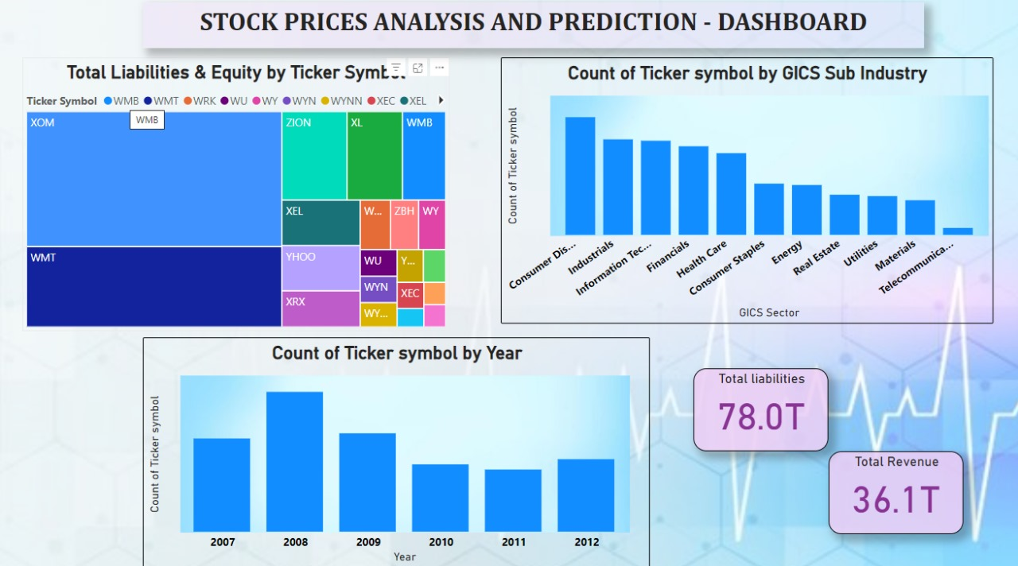

Slide 15
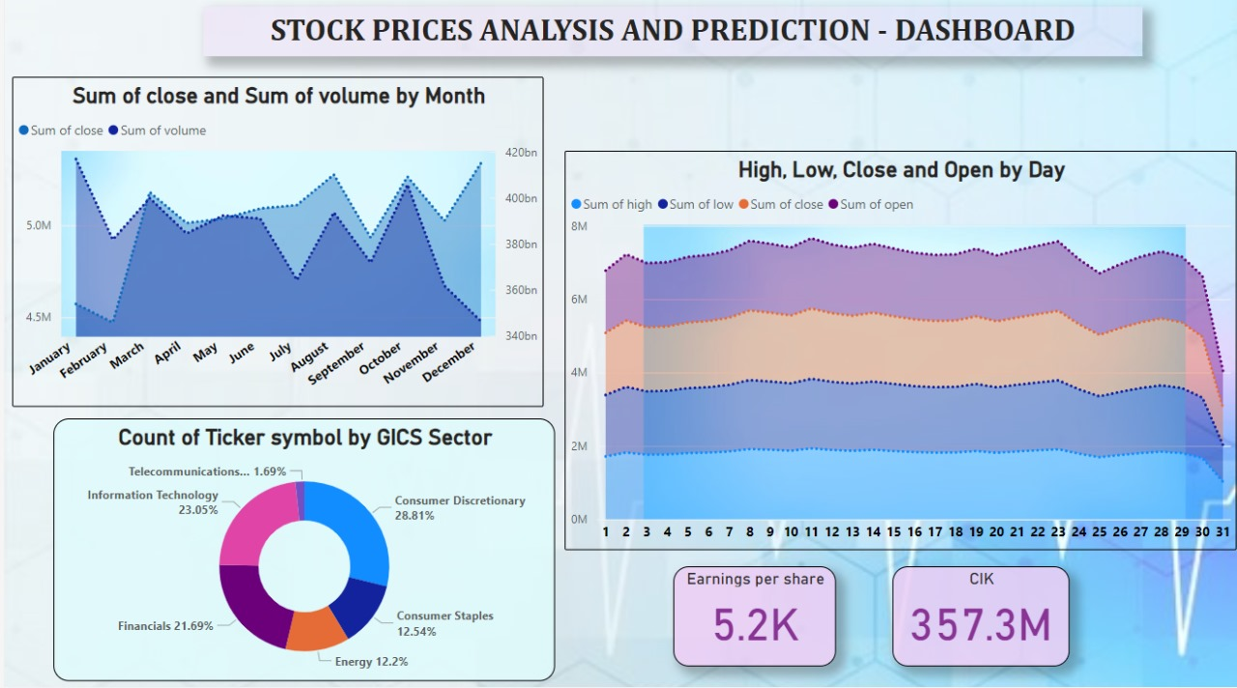

Slide 16
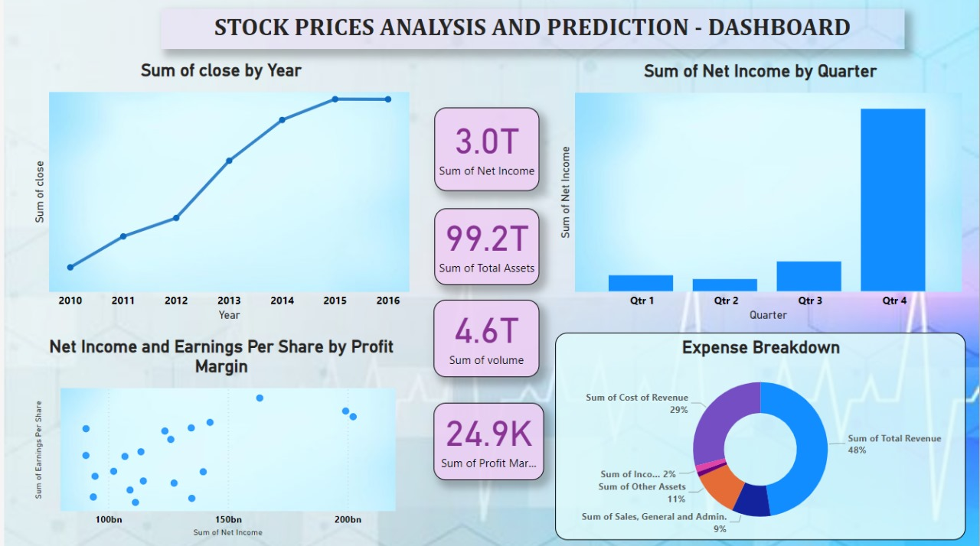

Slide 17
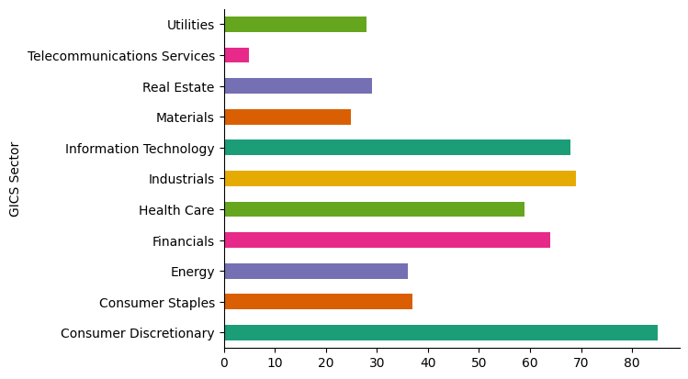
What are the most and least represented sectors in the dataset
The GICS Sector refers to the Global Industry Classification Standard (GICS), which is a system for categorizing companies into sectors and industries. Developed by MSCI and Standard & Poor's, the GICS framework consists of 11 sectors, each representing a broad category of economic activity.

Slide 18
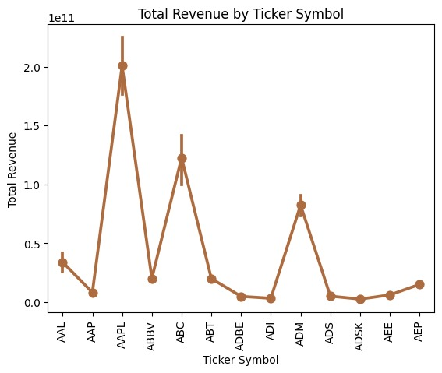
Identify which companies have higher or lower revenue.

Slide 19
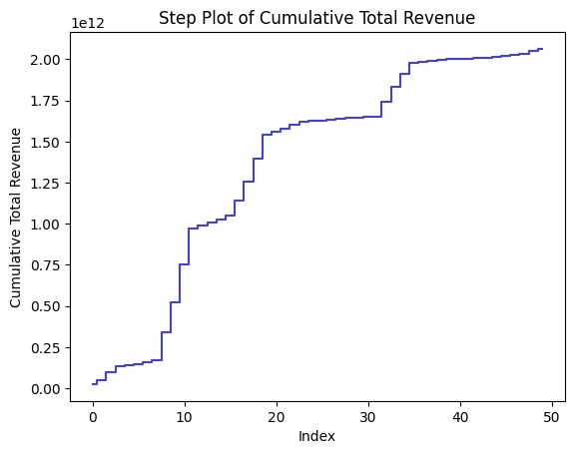
How total revenue accumulates over the data entries?

Slide 20
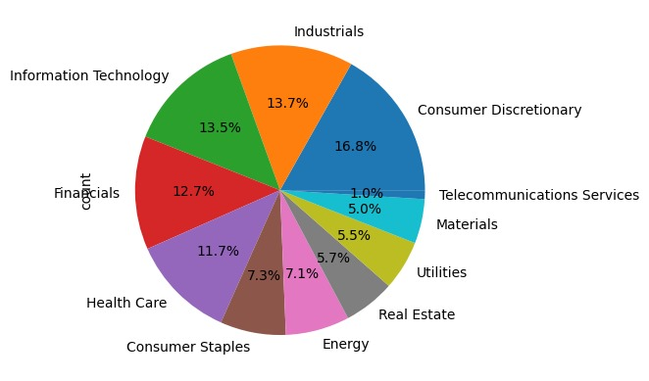
Display the sectors which are least prominent and most prominent

Slide 21
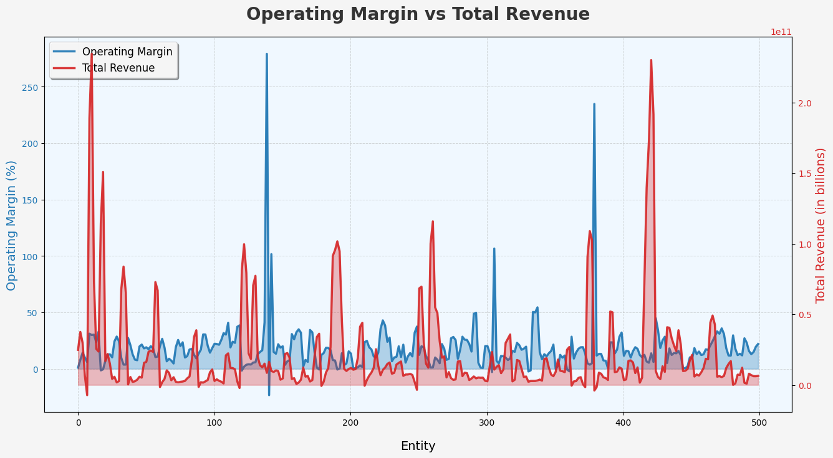
Operation Margin vs Total Revenue
Operation Margin
Operating margin measures the percentage of revenue that remains after covering operating expenses (excluding interest and taxes). It indicates how well a company manages its costs relative to its sales.
Total Revenue
Total revenue is the total income generated from the sale of goods or services before any expenses are deducted. It reflects the company’s overall sales performance.

Slide 22
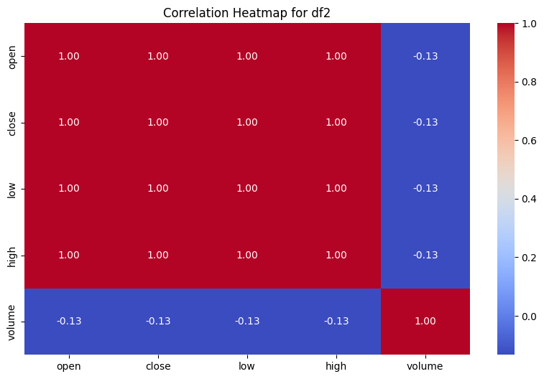
Prices-Split-Adjusted
This adjustment provides a clearer view of a stock's historical performance and is essential for accurate long-term trend analysis.
"Prices split-adjusted" refers to the adjustment of historical stock prices to account for stock splits. When a company splits its shares , the number of shares increases while the price per share decreases proportionally. This adjustment allows investors to analyze price trends without distortion caused by splits.

Slide 23
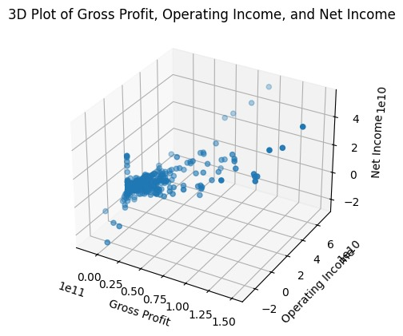
How are the measures Gross Profit, Operating Income and Net Income correlated?
Gross Profit: The profit a company makes after deducting the costs associated with producing and selling its products or services. It is a measure of production efficiency.
Operating Income: Also known as operating profit, this is the profit a company generates from its core operations, excluding non-operational income, taxes, and interest.
Net Income: Often referred to as the bottom line, this is the company's total earnings after accounting for all expenses, taxes, and interest.

Slide 24
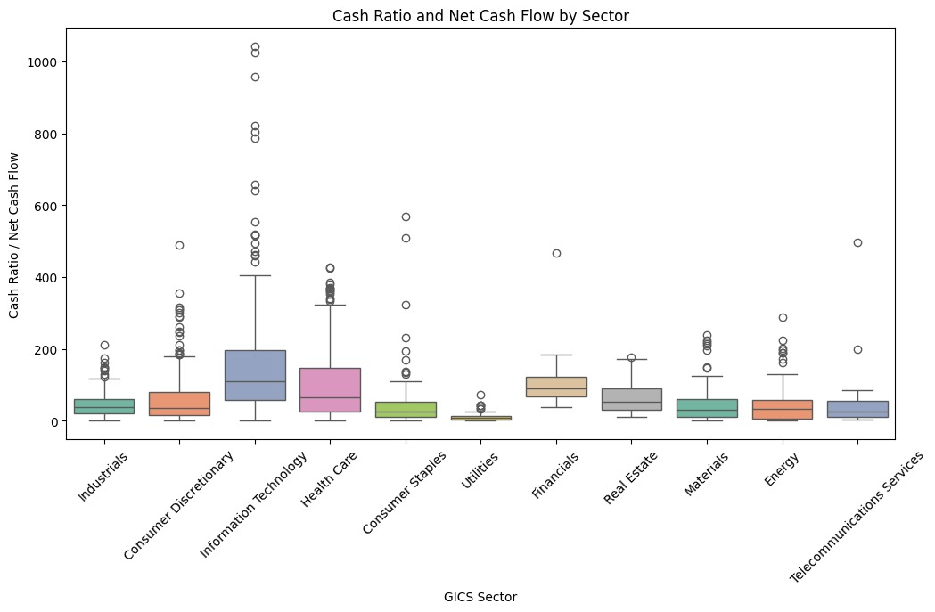
Find the GICS Sector with abnormal cash ratio / Net Cash Flow
The Global Industry Classification Standard (GICS) is a system used to categorize companies into sectors and industries based on their business activities. This framework helps investors and analysts compare companies within similar sectors and assess market trends.
Investment Analysis: Investors use GICS to diversify portfolios, analyze sector performance, and make informed investment decisions.

Slide 25
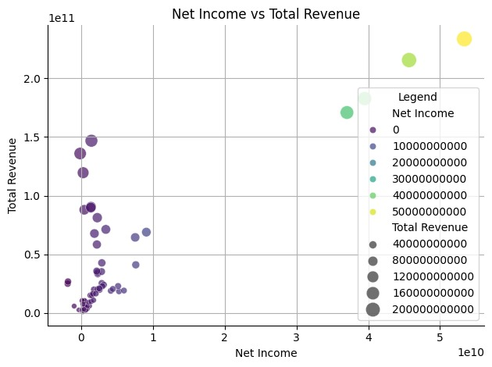
Display the relationship between net income and total revenue, indicating how they correlate, and visually emphasize variations in revenue through point size and color.
Net Incoome
Net income, also known as net profit or net earnings, is the total revenue minus total expenses, taxes, and costs. It reflects the profitability of a company over a specific period, typically reported on the income statement.
Net Cash Flow
Net cash flow measures the cash generated or used during a specific period, considering all cash inflows and outflows. It is reported on the cash flow statement and provides insights into a company’s liquidity and cash management.

Slide 26

CONCLUSION
Based on the analysis conducted with the fundamentals, prices, prices-split-adjusted, and securities datasets, the project "Stock Price Analysis and Prediction" yields several valuable insights and potential directions for predictive modeling. Below is a summary conclusion for each key aspect covered, along with insights relevant to stock analysis and forecasting
The comprehensive analysis from the datasets offers a strong foundation for both understanding current stock performance and forecasting future trends. By combining sector-specific insights, financial metric analysis, and historical price trends, this project establishes a nuanced approach for stock price prediction.

Slide 27

References
Datasets from kaggle and the prominent websites like seaborn, matplotlib, plotly for the kinds of plots that can be made, referring to the python snippets from them and using applying them relates to the specific plots in our projec

Slide 28
THANKS

